Slide 1

Strategic Information Systems Management Section 10 Developing IT capabilities Class Code: COMP423 H.Y Kan, Stanley Room: (WUI CHI) - 4/F, N46B Email: hykan@ipm.edu.mo Tel: 8599-6883

Slide 2
Introduction
Today’s competitive environment is driving IT departments to provide guaranteed levels of service at reduced costs. This can only be achieved by enhancing the way in which IT work is done.
As a result, IT executives are investigating revamping their internal IT capabilities as a vehicle to reduce IT costs, gain efficiencies, and improve the quality of their service in order to reap enhanced benefits from the IT investment.
This section explores how companies are managing and developing their internal IT capabilities and looks at how IT capabilities are identified, how people’s skills are mapped onto these capabilities, and how outcomes can be expected from a focus on capabilities

Slide 3
Why Focus on IT Capabilities?
In Information Technology, terms such as competencies, capabilities, skills, resources, services, experiences, processes, attitudes, procedures, and even methods are often used interchangeably. Therefore, it is important to clarify the terminology surrounding capability management:
Capability: This is the ability to marshal resources to affect a predetermined outcome. Portfolio management, for instance, is the capability to manage a set of IT applications as a logical whole.
Competency: this is the degree of proficiency in marshalling resources to affect a predetermined outcome. Thus, a capability indicates your ability to do something, whereas competency reflects how good you are at doing it.
Processes: These are well-defined activities within capabilities. Portfolio management, for instance, includes the following processes: business case development, project prioritization, resource allocation, performance benchmarking, and portfolio analysis.
Procedures and methods: These are “how to” or step-by-step instructions for implementing a process.

Slide 4
Why Focus on IT Capabilities? (Cont’d)
Researchers believe that there is a direct linkage between IT capabilities and organizational value/long-term competitiveness.
The development of Nine Core IT capabilities is necessary for IT organizations to meet three enduring challenges of uniting business and IT vision, delivering IT services, and designing an IT architecture:
Leadership: Integrating IT effort with business purpose and activities.
Business systems thinking: Envisioning the business process that technology makes possible.
Relationship building: Getting the business constructively engaged in IT issues.
Architecture planning: Creating a coherent blueprint for a technical platform that responds to current and future business needs.
Making technology work: Rapidly achieving technical progress by one means or another.

Slide 5
Why Focus on IT Capabilities? (Cont’d)
Informed buying: Developing and managing an IT sourcing strategy that meets the interests of the business.
Contract facilitation: Ensuring the success of existing contracts for IT services.
Contract monitoring: Protecting the business’s contractual position, current and future.
Vendor development: Identifying the potential added value of IT service suppliers.

Slide 6
A Framework for Developing Key IT Capabilities
Step 1: Create a Capability Management Office
Step 2: Identify Essential IT Capabilities
Step 3: Subdivide Capabilities into Processes
Step 4: Assess maturity Level of IT Capabilities
Step 5: Map Skills onto IT Capabilities

Slide 7
Step 1: Create a Capability Management Office
The capability management office is the focal point for capability development and management (i.e., Step 2).
Its creation also signals the importance IT senior management attaches to this activity.
In reality, it may operate under the name of “capability support group” or “capability council.”
Responsibilities of this office:
Define and assign responsibility for all capabilities
Develop strategies for the development of these capabilities.
Ensure that adequate resources and funding are provided to develop them.
Secure software support for these activities.
Adopt a continuous capability improvement approach.
Develop organizational training plans.
Report the status of organizational capability performance.

Slide 8
Step 2: Identify Essential Capabilities Aligned with Business Goals
Each IT organization should go through the exercise of identifying its essential capabilities and linking them with business goals.
However, these capabilities shouldn’t be aligned too closely with current business practices. Capabilities should be less functional and focus more on the outcomes that the organizations need to be able to create.
Identifying essential capabilities is largely an internal IT exercise. We need to make sure that the list of capabilities is not too IT-oriented.

Slide 9
Step 2: Identify Essential Capabilities Aligned with Business Goals (Cont’d)
Example (Firm A): A list of capabilities that involve IT terminology:
Skills regeneration
Enterprise architecture
Shared services governance and development
Development methodology
Project initiation and investment management
Business process definition and change management
Infrastructure alignment and crisis control
Partner management and outsourcing

Slide 10
Step 2: Identify Essential Capabilities Aligned with Business Goals (Cont’d)
Example (Firm B): A list of capabilities that devoid of IT terminology:
People management
Strategy and planning
Portfolio management
Resource management
Solution delivery
Service management
Asset management

Slide 11
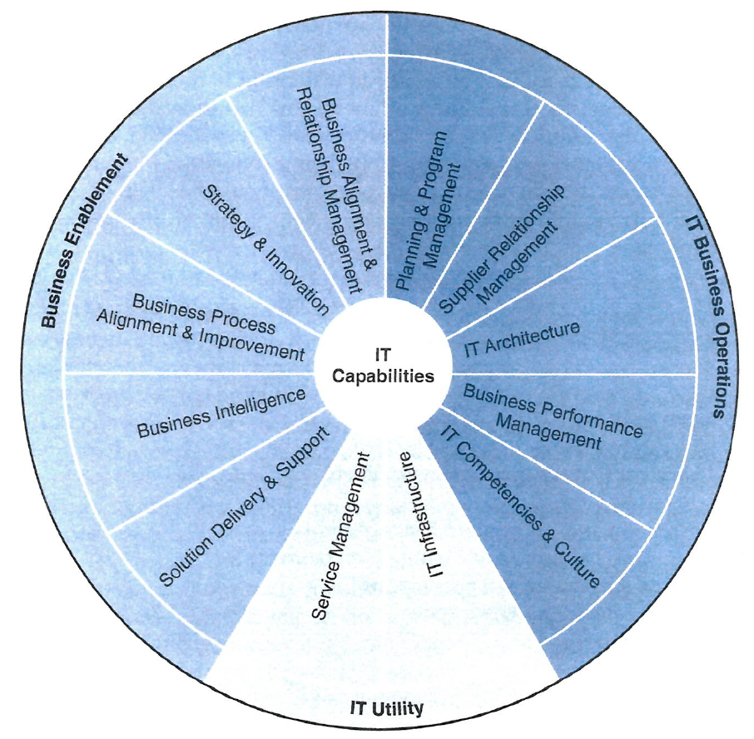
Step 2: Identify Essential Capabilities Aligned with Business Goals (Cont’d)
Example (Firm C): The capability wheel
The number of capabilities is typically be between seven to twelve.

Slide 12
Step 3: Subdivide IT Capabilities into Key Processes
Once key capabilities have been identified, the next step is to subdivide them into processes.
The result of this step should be a st of well-defined activities that can be measured and managed. A set of well-articulated processes enables organizations to evaluate their overall performance with respect to key capabilities.
For example, using the second list of capabilities (Slide #10), we can divide the capabilities into 40 processes, as shown in the following slides.

Slide 13
Step 3: Subdivide IT Capabilities into Key Processes (Cont’d)
Capabilities | Processes
1. People Management | Recruiting and hiring Coaching and motivating Performance management and career planning Identifying and developing talent
2. Strategy and Planning | Account management External benchmarking Strategy development Architecture development Business process influence/enabling IT marketing

Slide 14
Step 3: Subdivide IT Capabilities into Key Processes (Cont’d)
Capabilities | Processes
3. Portfolio Management | Business case development Project/service prioritization Portfolio investment determination Resource investment/allocation Performance benchmarking Portfolio analysis
4. Resource Management | Staff strategy development Resource capacity management Staff sourcing Resource assignment Budget management

Slide 15
Step 3: Subdivide IT Capabilities into Key Processes (Cont’d)
Capabilities | Processes
5. Solution Delivery | Project management Solution configuration Solution development and integration Architecture implementation Solution verification and validation
6. Service Management | Solution release Service-level management Asset availability management Asset capacity management Incident management Problem management Change management

Slide 16
Step 3: Subdivide IT Capabilities into Key Processes (Cont’d)
Capabilities | Processes
7. Asset Management | Asset inventory management Asset affiliation management Asset life cycle management Security/permeability enforcement Supplier relationship management Lease/contract management Knowledge management
Popular process frameworks include IT Infrastructure Library (ITIL) and Control Objectives for Information and Related Technology (COBIT).
However, adopting externally defined processes runs the risk of appearing foreign to IT staff, making it more difficult for them to develop an understanding and to foster feelings of ownership.

Slide 17
Step 4: Assess the Maturity Level of IT Capabilities
The Capability Maturity Model (CMM) is arguably the most widely accepted (https://en.wikipedia.org/wiki/Capability_Maturity_Model).
The model has five levels:
Level 1 (initial): Software development follows few rules. The project may go from one crisis to the next. The success of the project depends on the skills of individual developers. They may need to finish the project in a heroic effort.
Level 2 (repeatable): Software development successes are repeatable. The organization may use some basic project management to track cost and schedule. The precise implementation differs from project to project within the organization.

Slide 18
Step 4: Assess the Maturity Level of IT Capabilities (Cont’d)
Level 3 (defined): Software development across the organization uses the same rules and events for project management. Crucially, the organization follows the same process even under schedule pressures, ideally because management recognizes that it is the fastest way to finish.
Level 4 (managed): Using precise measurements, management can effectively control the software development effort. In particular, management can identify ways to adjust and adapt the process to particular projects without measurable losses of quality or deviations from specifications.
Level 5 (Optimizing): Quantitative feedback from previous projects is used to improve project management, using the measurement skills shown in Level 4.
Organizations can create their own levels, e.g., no capability, aware, developing, practicing, optimizing, leading.

Slide 19
Step 5: Link IT Skills to IT Capabilities
The final part of the framework for IT capability development is the link between skills and capabilities. Failure to do this results in a significant disconnect between individuals and capabilities and a belief that individuals have little to do with capability maturity beyond that of following the dictates of established procedures.
In the previous table of processes, we can see that the processes are very closely related to individual skills.
Typically, there are three types of IT skills: (1) business, (2) technical, and (3) interpersonal, differing in terms of level of expertise.
For example, IT leadership capability requires
A high level of business skills
A medium level of technical skills
A high level of interpersonal skills

Slide 20
Step 5: Link IT Skills to IT Capabilities (Cont’d)
When roles are mapped to processes and processes are mapped to capabilities, it is possible to connect individuals to the capabilities that have been identified as being critical for the IT organization.
Furthermore, these matrices make the progression between levels within roles explicit (business analyst → senior business analyst) and, therefore, the focus of annual performance reviews and career advancement discussions.
The process skills can be included in internal training programs for job roles. This ensures awareness and knowledge of key processes across the IT department.
Capability
Processes
Roles

